Slide 1

Software Engineering
TaskTenders
Capstone Project Phase A - 24-2-D-42
Students:
Safa Khier 322829102
Layan Amer 323068700
Supervisor:
Dr. Zakharia Frenkel

Slide 2
tasktenders
Introduction
In the gig economy, customers seek dependable freelancers for diverse tasks, while freelancers strive for visibility and fair opportunities. Both groups face challenges in trust and transaction security, underscoring the need for robust mechanisms that ensure reliability and streamline interactions for all parties involved.
Freelancer Engagement in the
Gig Economy
Bridging the Gap

Slide 3

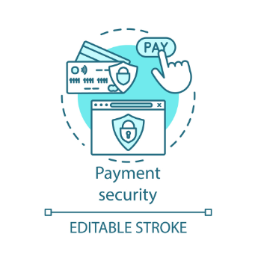

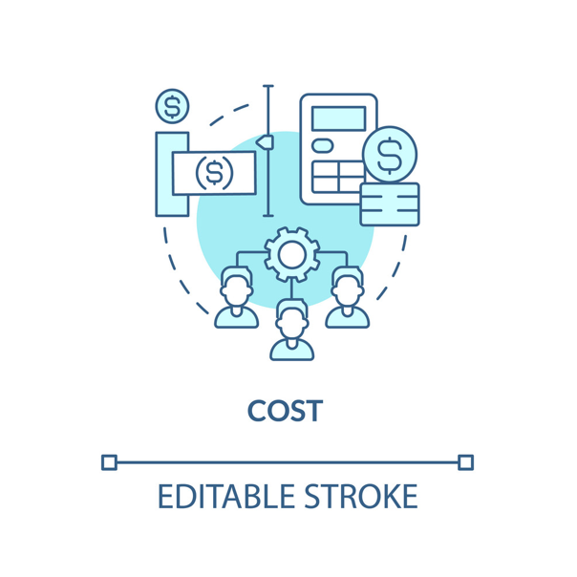
tasktenders
In the growing gig economy, customers and freelancers face challenges that impact effective collaboration. Customers often can't find reliable freelancers, struggling with trust and payment security, while freelancers lack consistent work and visibility. These widespread issues highlight the critical need for a solution that builds trust, enhances security, and streamlines transactions.
The Problem
Trust Issues
Payment Security
Inconsistent Work Opportunities
Pricing Exploitation

Slide 4
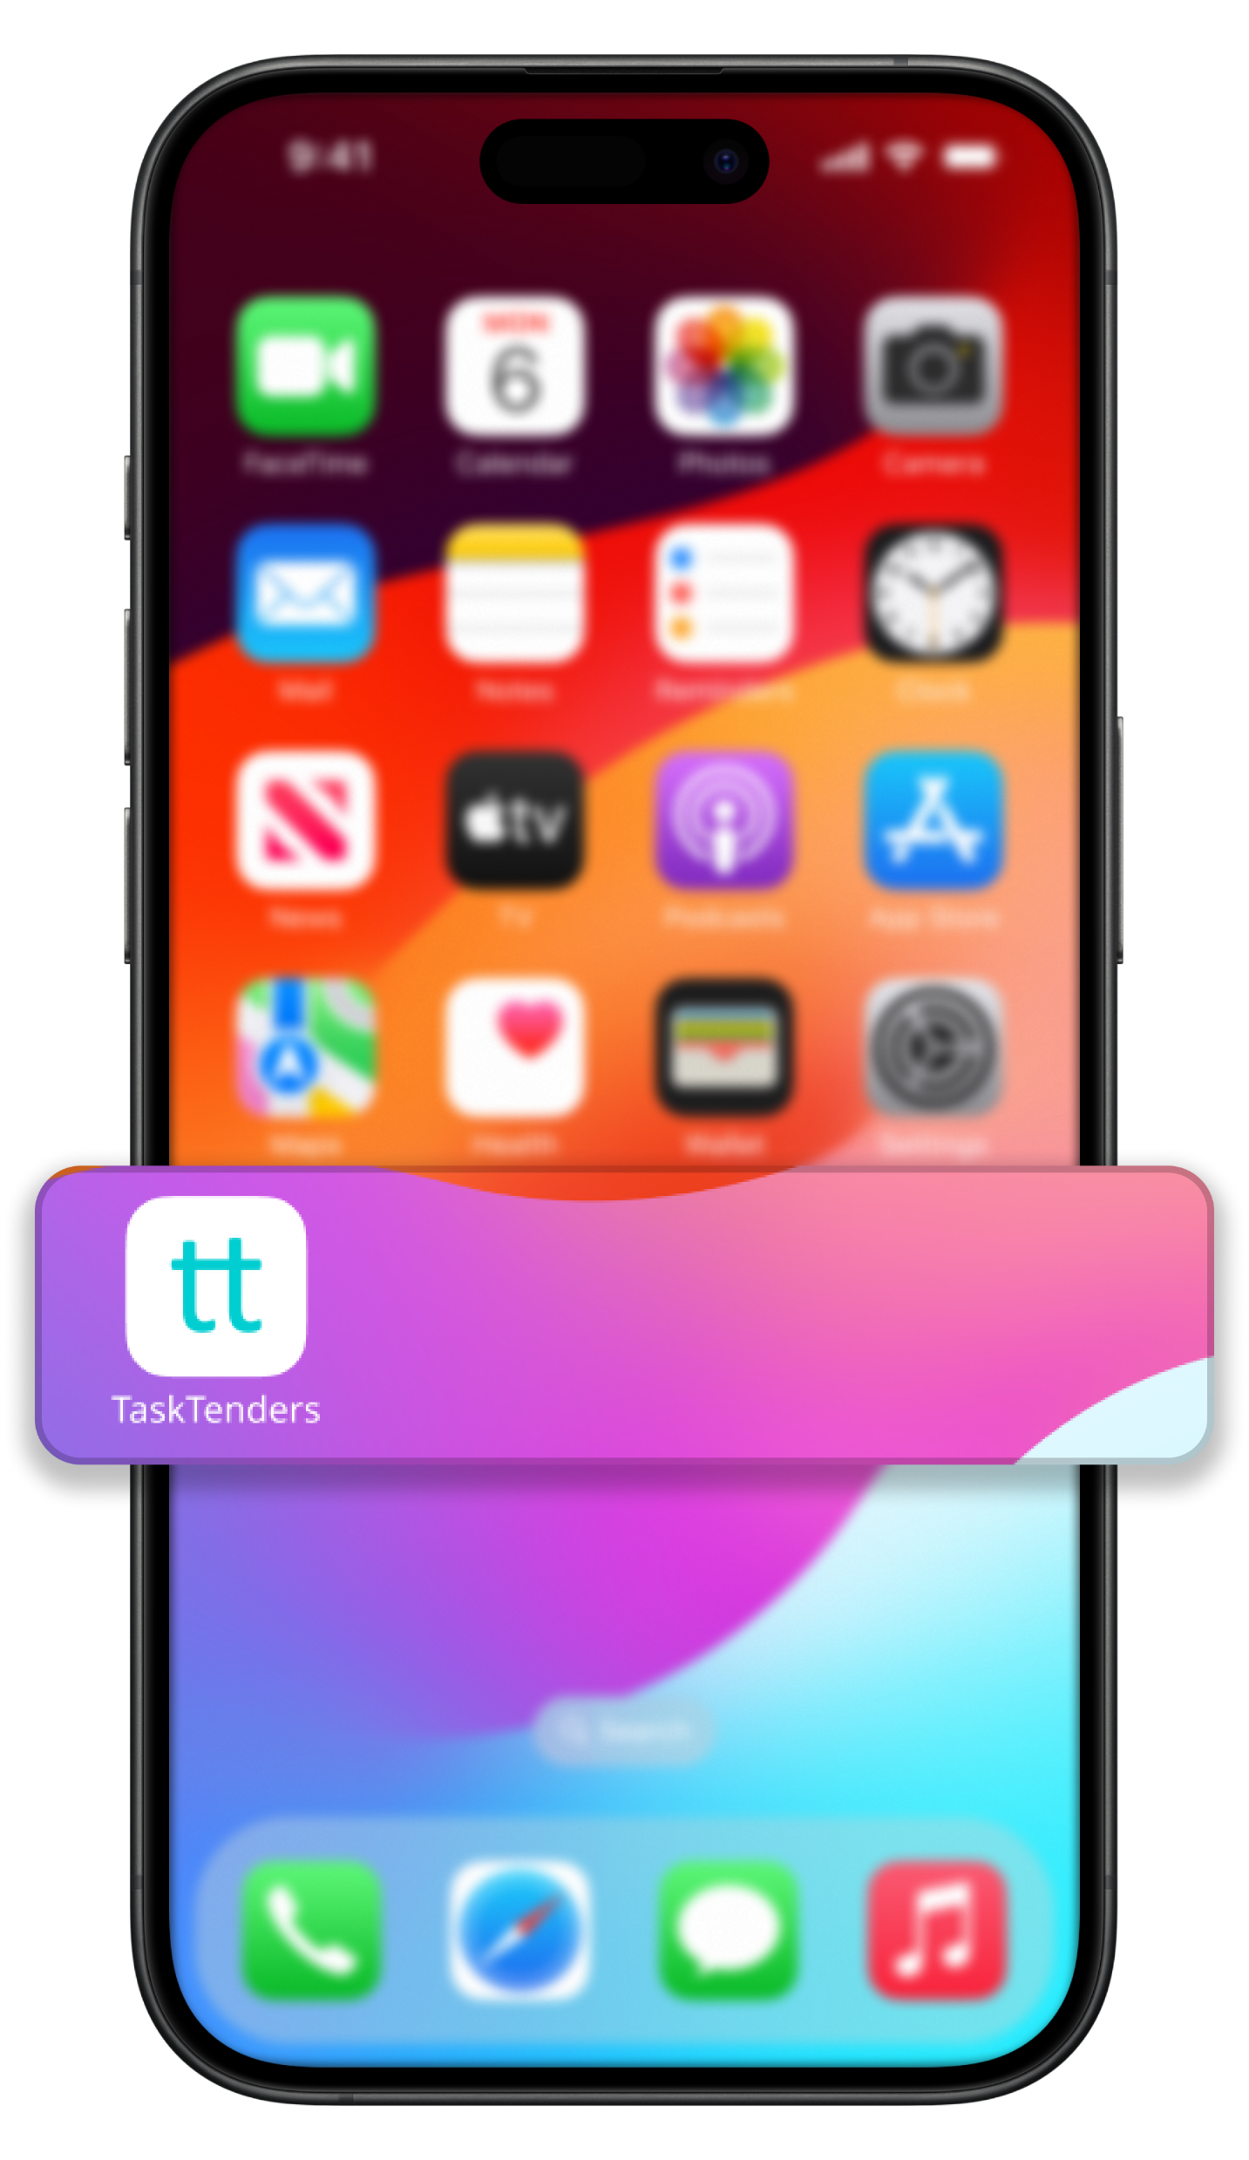
tasktenders
TaskTenders
Our Solution
TaskTenders addresses the gig economy’s challenges through a precision matching system that connects clients with verified freelancers. Our secure payment system with escrow ensures transaction safety, while a detailed review system builds trust and transparency. Together, these features streamline the hiring process, enhancing satisfaction and efficiency for all users.
Freelance Application

Slide 5
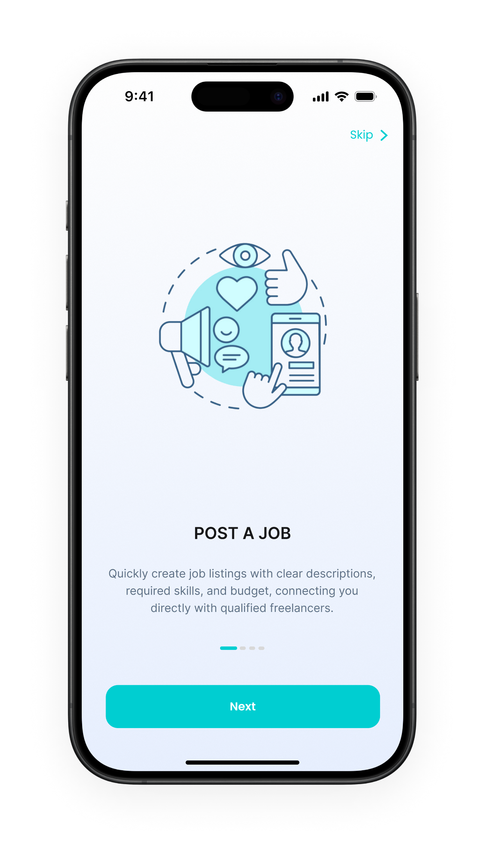
tasktenders
Users Can Post Jobs Or Search a Service
Users can quickly post and share job listings on our platform, detailing requirements and budget. This facilitates broad exposure across social networks, attracting qualified freelancers efficiently and effectively.

Slide 6
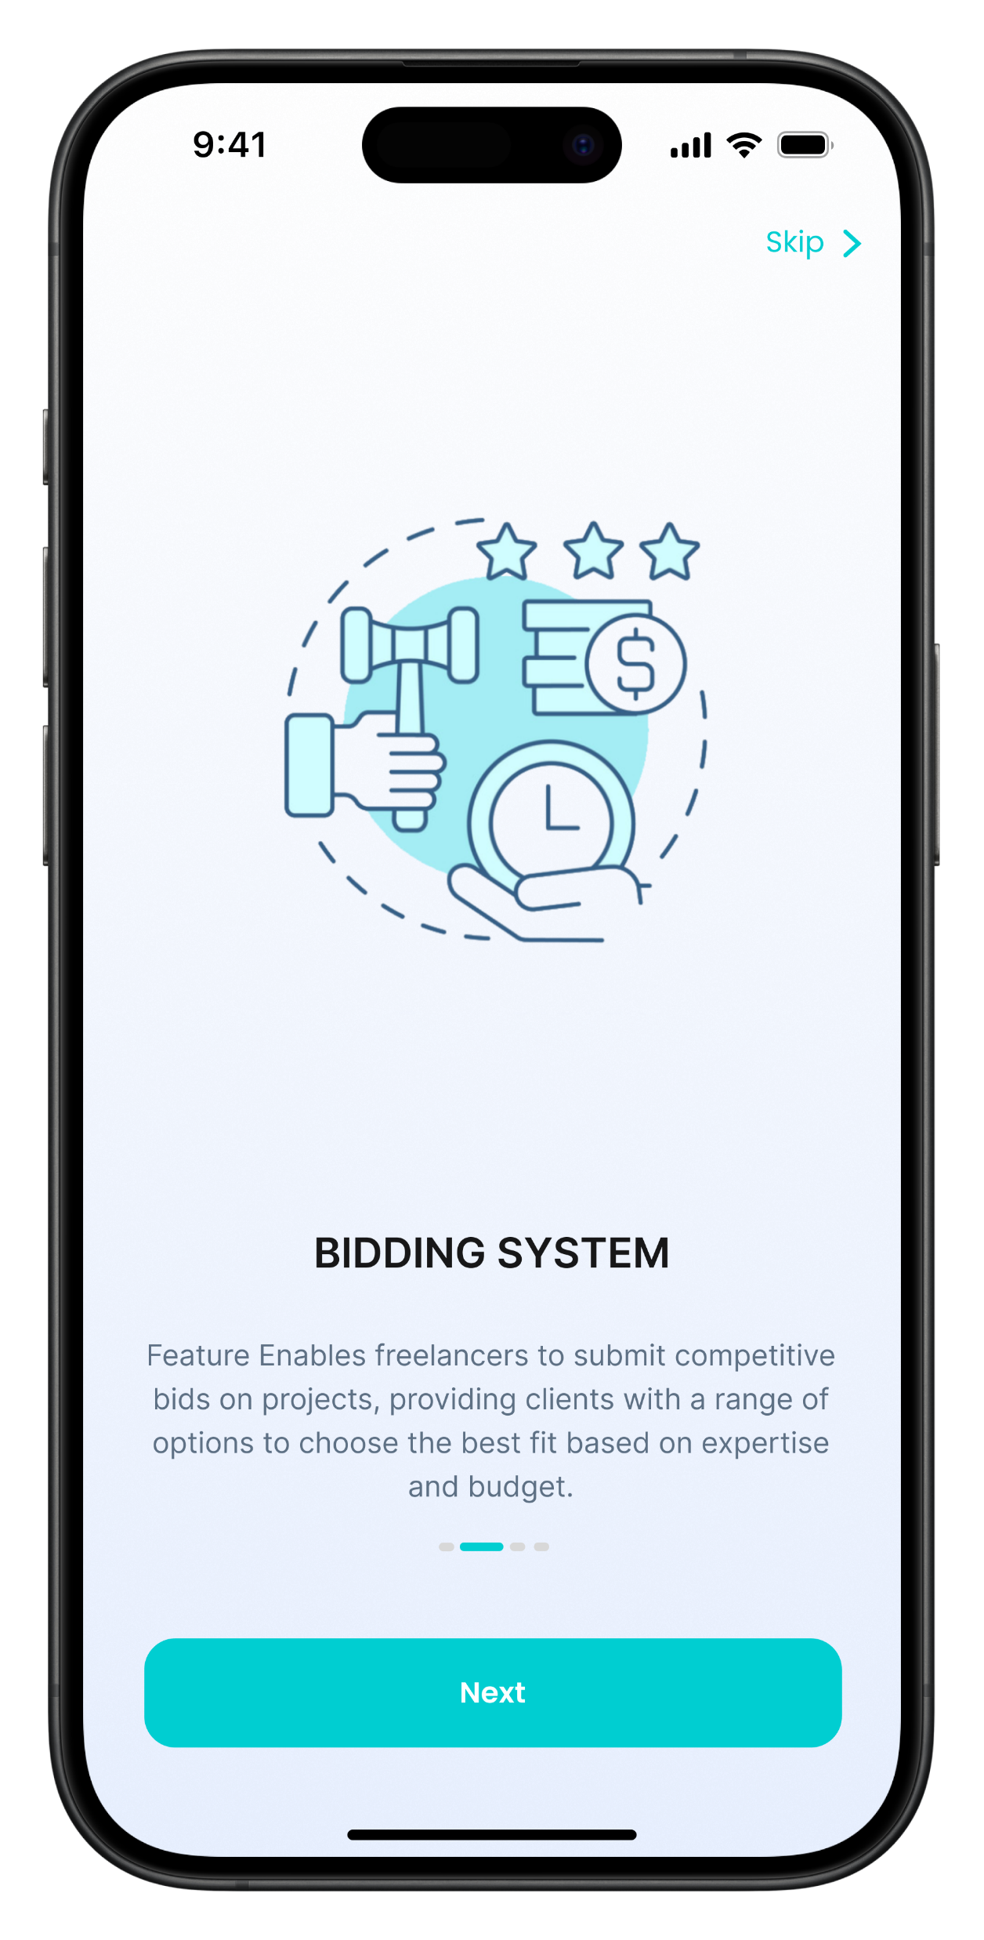


tasktenders
Freelancers Can View Jobs And Bid On It
Bidding System
Our bidding system lets freelancers competitively bid on projects, giving clients a range of choices to find the best match for their budget and needs.
Welcome to
MockApps
Chat Per Tender
Facilitates direct communication between freelancers and clients within each project bid, enhancing clarity and collaboration.
Install

Slide 7
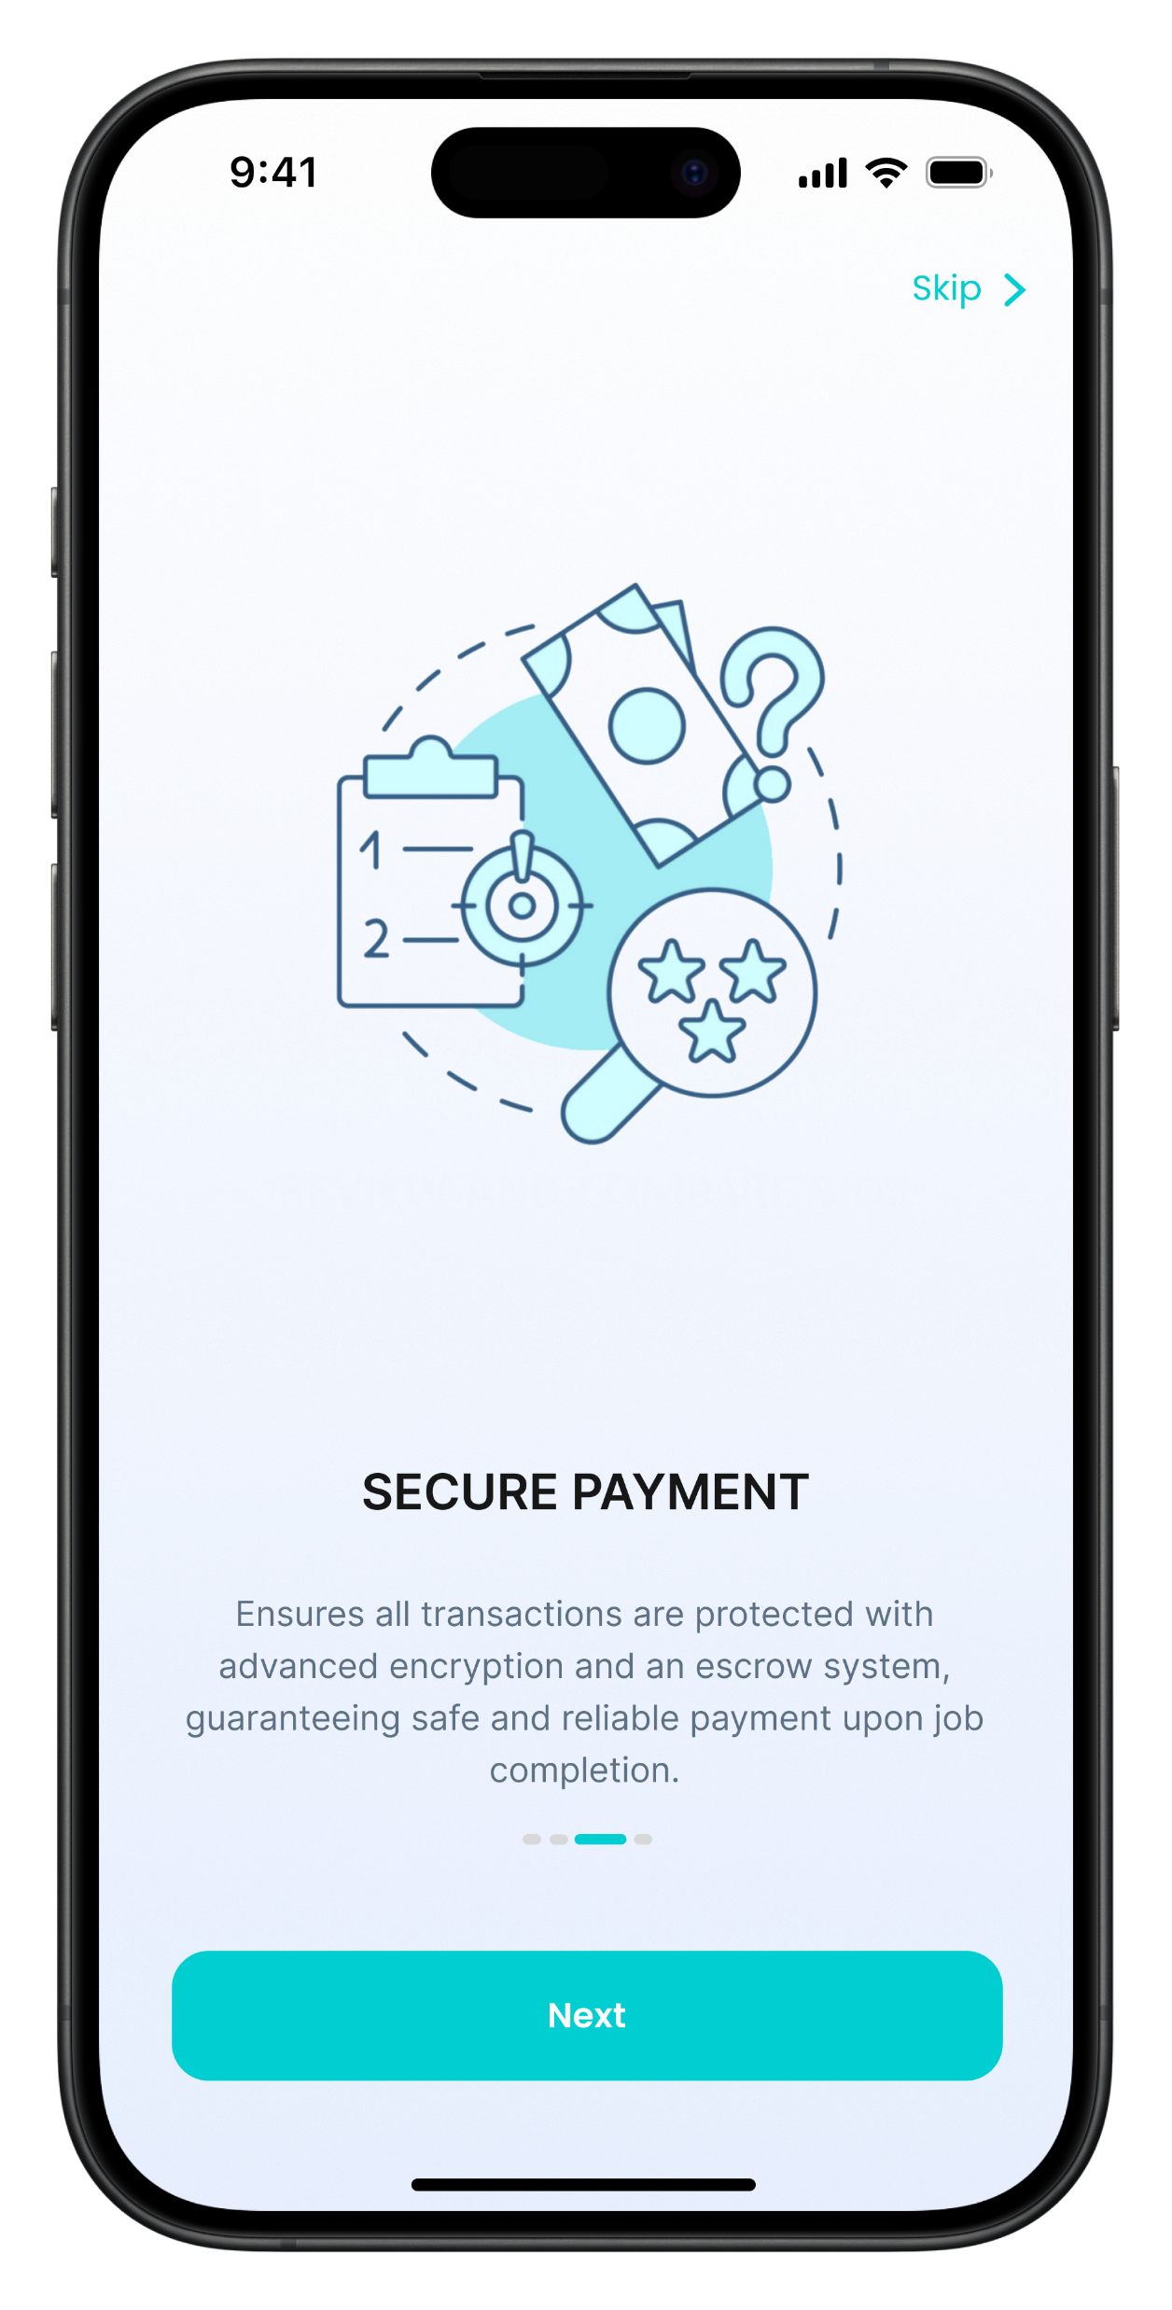
tasktenders
Multiple And Secure Payment Methods
Credit/Debit Cards
Bank Transfers
01
02
Processed through PCI DSS-compliant gateways to ensure transaction security.
Enabled via direct bank integrations for secure and direct account funding.
E-Wallets
Escrow Payments
03
04
Support for major digital wallets like PayPal, Apple Pay, and Google Wallet ensures fast and secure transactions.
Maintains funds in a secure third-party account until service delivery is confirmed, safeguarding both freelancer and client interests.

Slide 8
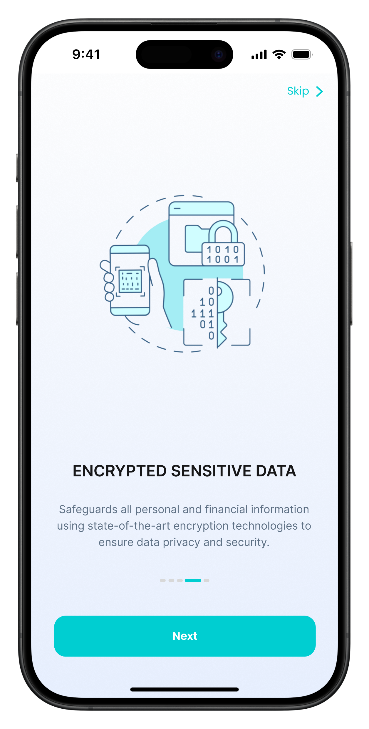


tasktenders
Encrypted Sensitive Data
Advanced Encryption Standards (AES)
Utilizes AES-256 encryption to protect data, which is the gold standard for securing sensitive information.
Welcome to
MockApps
End-to-End Encryption
communications and transactions are encrypted from start to finish, safeguarding data against interception and unauthorized access.
Install

Slide 9
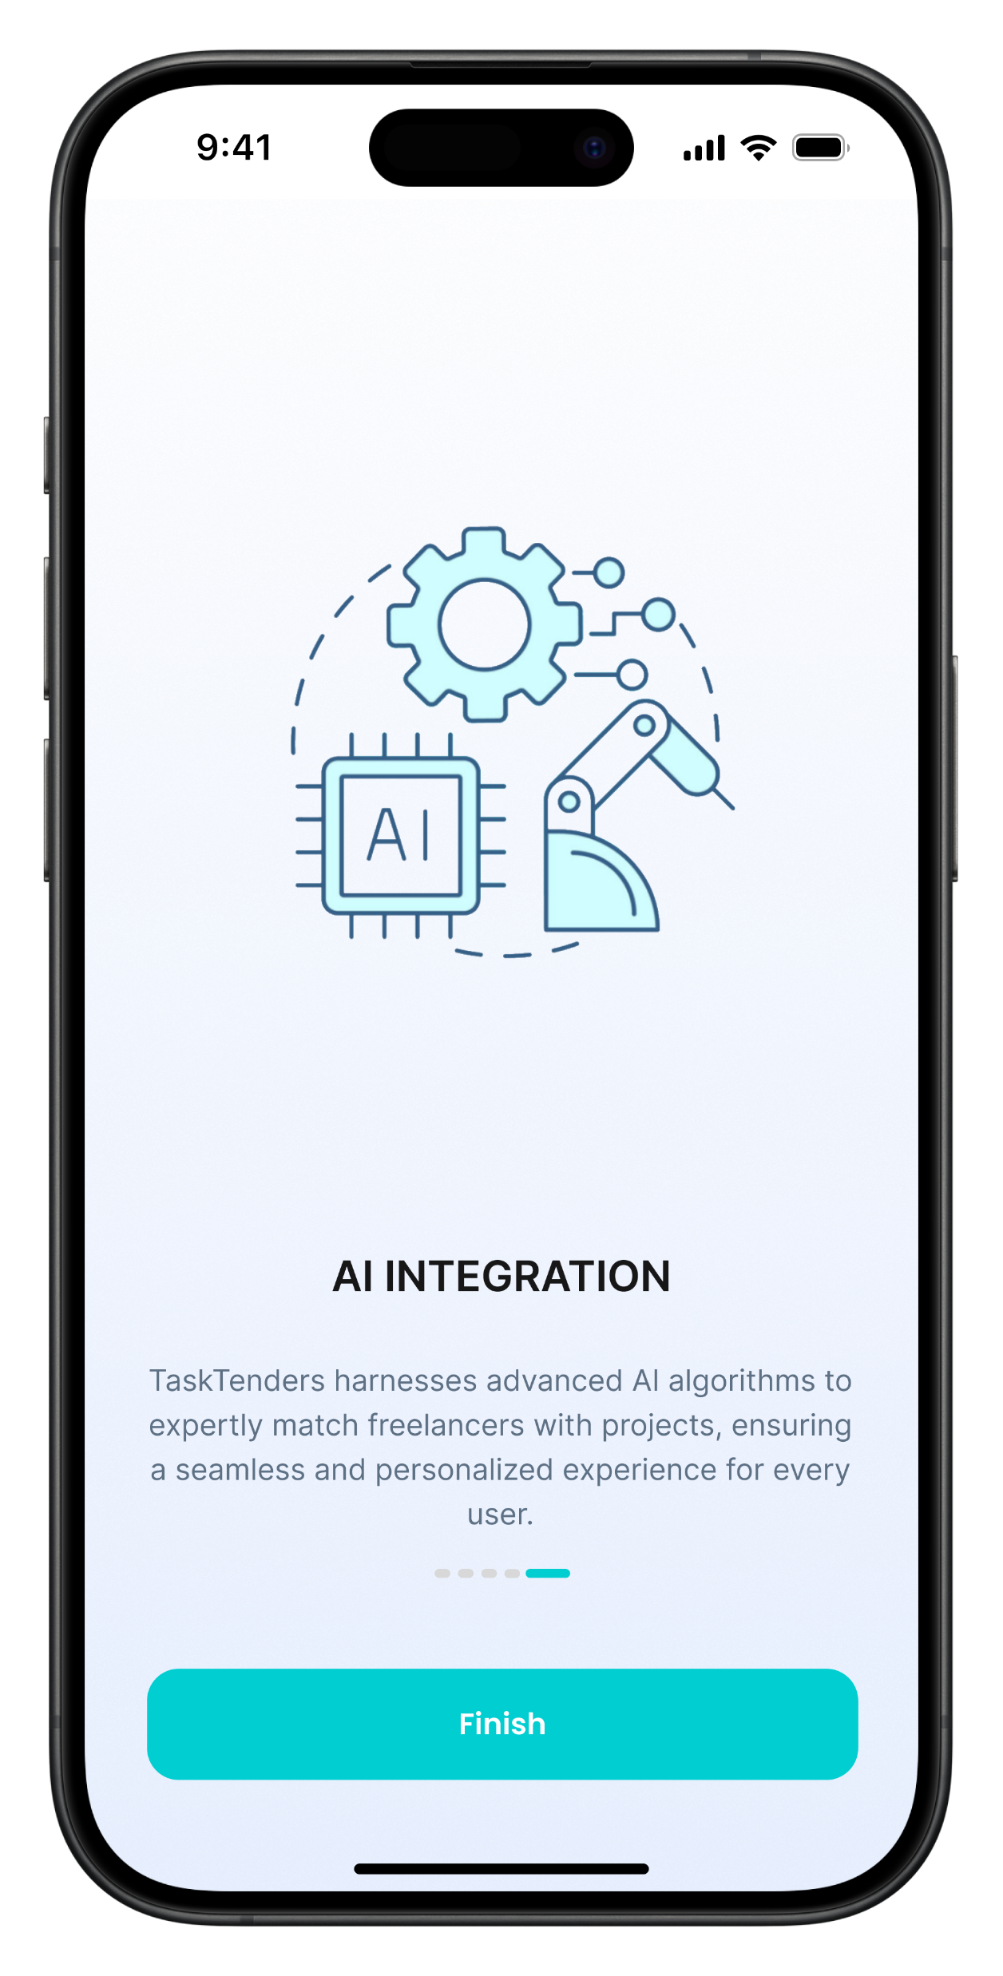
tasktenders
Smart Matching Algorithm Based On AI
TaskTenders utilizes cutting-edge AI technology to streamline the matchmaking process between freelancers and projects. Our sophisticated algorithms analyze user profiles and past performance to recommend the best matches, optimizing both satisfaction and efficiency. This AI-driven approach ensures that every match is tailored to the specific needs and skills of our users, enhancing the overall experience and success of the platform.

Slide 10
tasktenders
AI Technology Overview
Our AI technology at TaskTenders is designed to enhance the matchmaking process between freelancers and projects. By utilizing advanced algorithms, the system analyzes a range of data points from user profiles, including past job performance, skills, and preferences. This analysis helps in predicting the best project matches for freelancers, ensuring a high compatibility and success rate. Our AI continuously learns and adapts, improving its recommendations over time to keep up with the evolving needs of our users.
Collaborative Filtering
Content-based Filtering

Slide 11

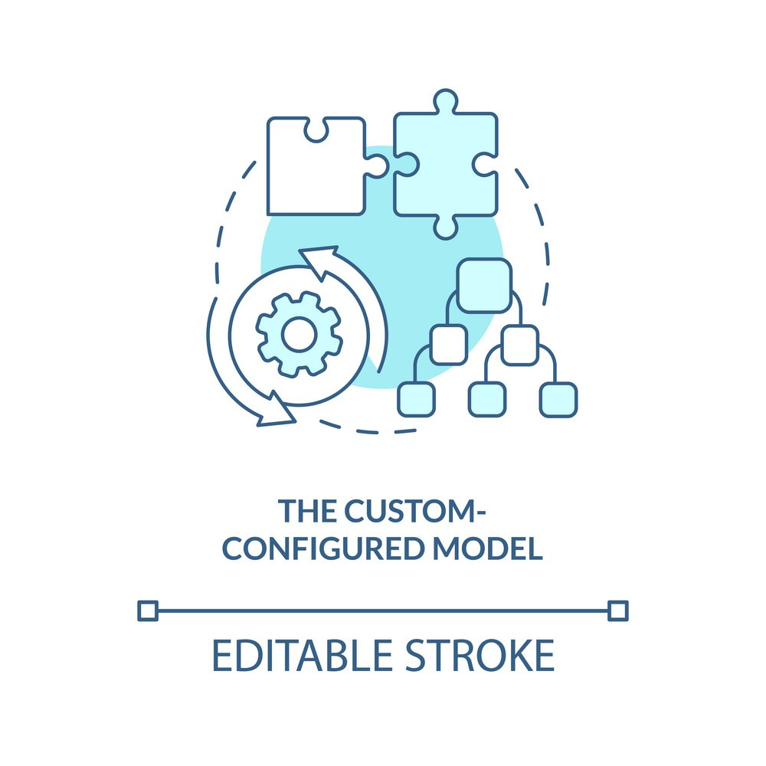

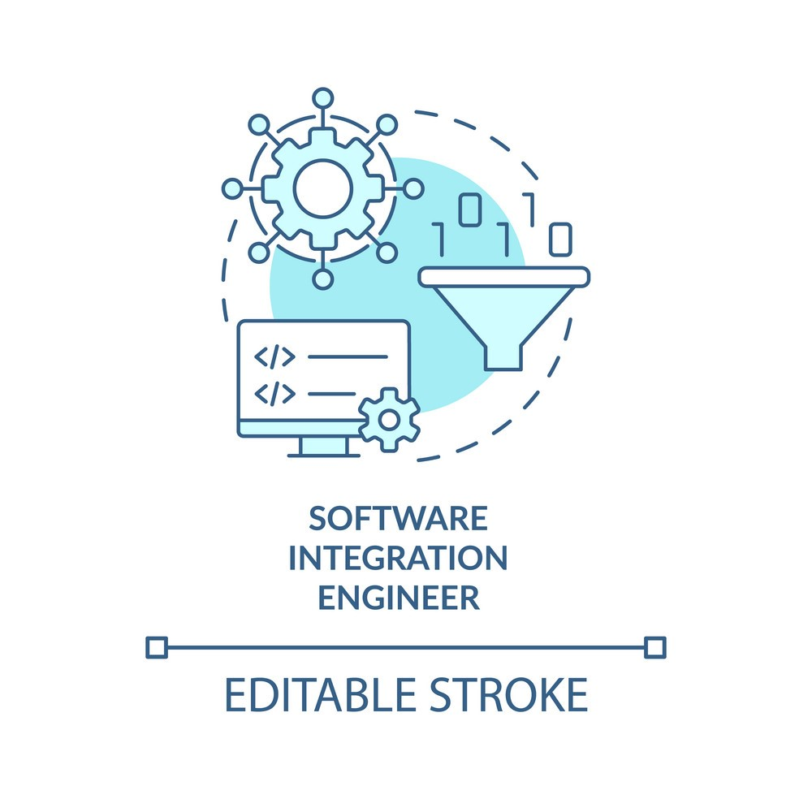



tasktenders
AI Implementation Steps
Data Collection
Model Development
Training and Testing
API Integration

Slide 12


tasktenders
Using Flutter and Dart for Frontend Development
Flutter
Dart
Flutter allows us to write once and deploy on both iOS and Android
Dart code is compiled directly into native ARM code, ensuring optimal performance across all platforms.

Slide 13



tasktenders
Backend Technologies for TaskTenders
Node.js
Express.js
MongoDB
Acts as the runtime environment for executing JavaScript code server-side
This web application framework for Node.js is used to build web applications and APIs
A NoSQL database used to store application data in a flexible, JSON-like format

Slide 14
tasktenders
3-Tier Architecture
Presentation Tier
Logic Tier
Data Tier
Client
Server
Database

Slide 15
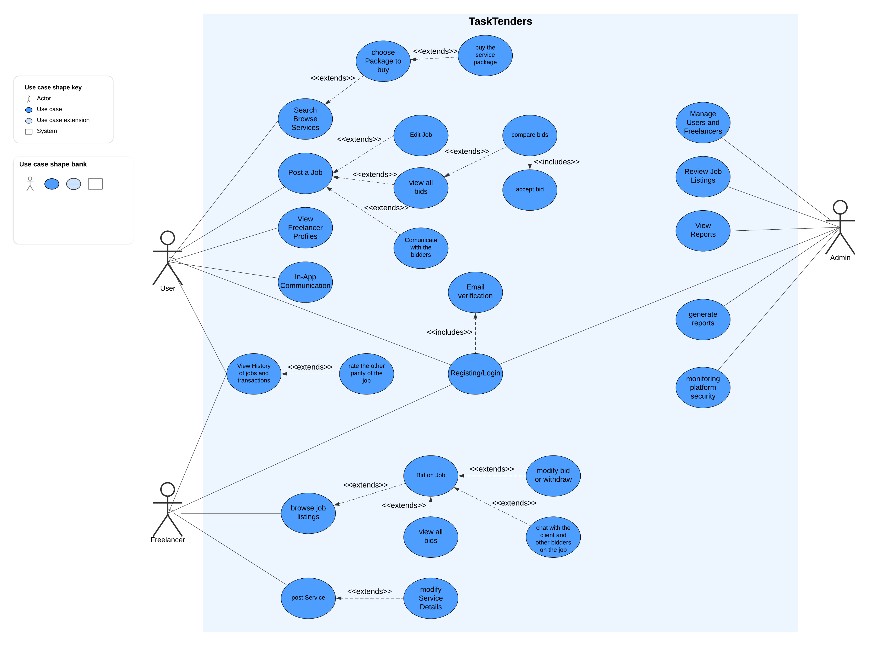
tasktenders
tasktenders
Use Case Diagram

Slide 16
tasktenders
Test Cases Scheme Example - User
Test ID | Description | Method | Expected Outcome
U1 | Update profile information | Integration Test | Profile is updated with new information
U2 | Delete user account | Manual Testing | User account is deleted correctly
U3 | View job history | Automated Test | User can view past jobs accurately
U4 | Account registration verification | Automated Test | User receives verification email
U5 | Change password functionality | Manual Testing | Password change is processed correctly
U6 | Mobile app login with biometrics | System Test | User can log in using biometric data
U7 | Handling of user session timeouts | Automated Test | User is logged out after inactivity
U8 | Search and filter jobs | Integration Test | Search returns accurate results

Slide 17
tasktenders
Test Cases Scheme Example - Freelancer
Test ID | Description | Method | Expected Outcome
F1 | Bid on job posting | Automated Test | Freelancer can submit bids successfully
F2 | Withdraw from bid | Manual Testing | Freelancer can withdraw bid correctly
F3 | Complete job and receive payment | Integration Test | Job completion triggers payment correctly
F4 | Manage portfolio | Manual Testing | Freelancer can update their portfolio
F5 | Receive and respond to client queries | Integration Test | Communication with clients is seamless
F6 | Notification settings adjustment | System Test | Freelancer can customize notifications
F7 | Review and rate clients | Automated Test | Freelancer can submit reviews and ratings

Slide 18
tasktenders
Test Cases Scheme Example - Manager
Test ID | Description | Method | Expected Outcome
A1 | Add new job categories | Manual Testing | Admin can add new categories successfully
A2 | Ban a user | Automated Test | User is banned and cannot access system
A3 | Generate reports | Integration Test | Admin can generate accurate reports
A4 | Manage user complaints | Manual Testing | Complaints are resolved efficiently
A5 | Update platform policies | System Test | Policy updates are deployed correctly
A6 | Monitor user activity | Automated Test | Admin can monitor and review user activity
A7 | Backup and data recovery procedures | Integration Test | Data recovery processes function properly

Slide 19
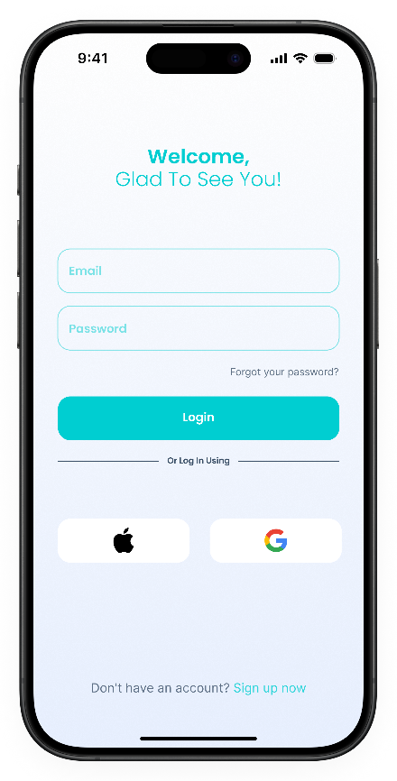
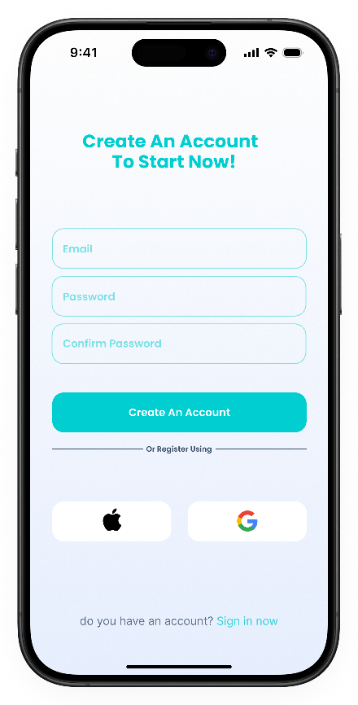
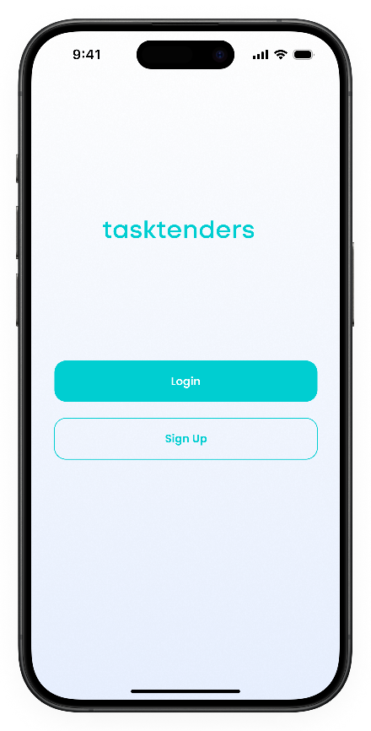
tasktenders
Login and sign-up
Screens

Slide 20
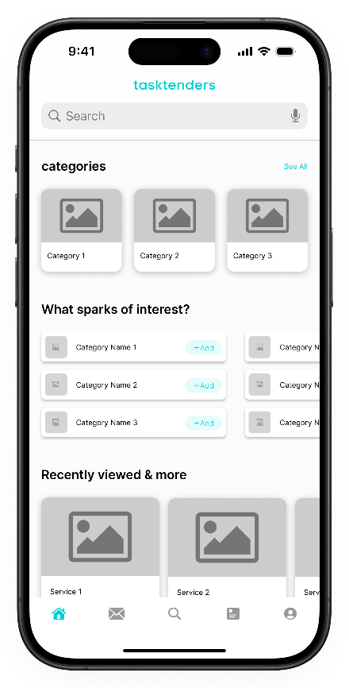
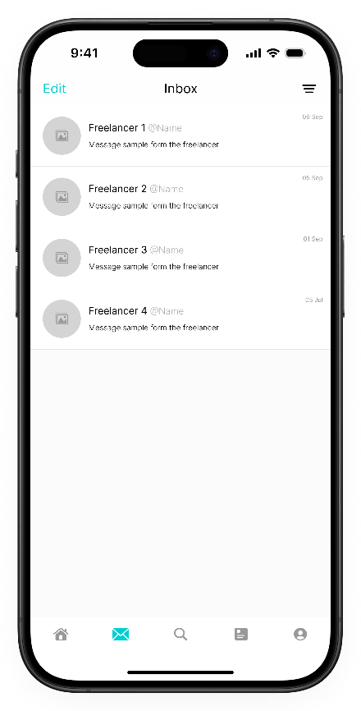
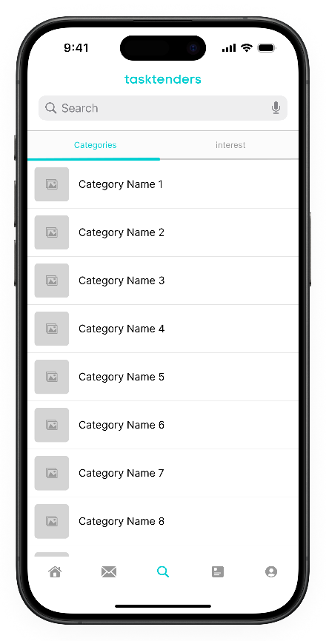
tasktenders
Inbox Tab
User’s Screens
Home Tab
Search Tab

Slide 21
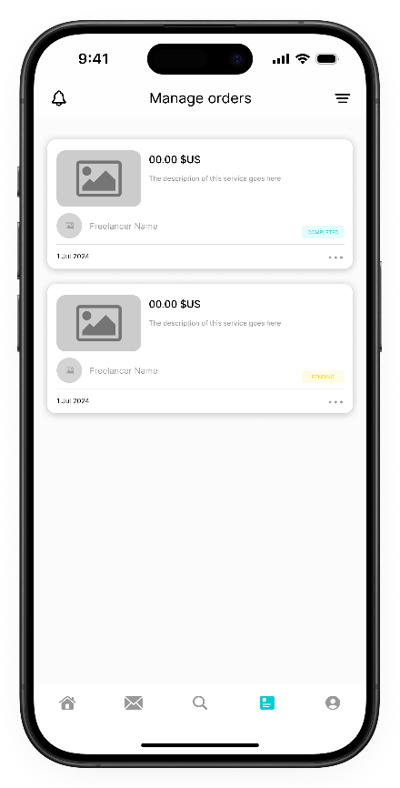
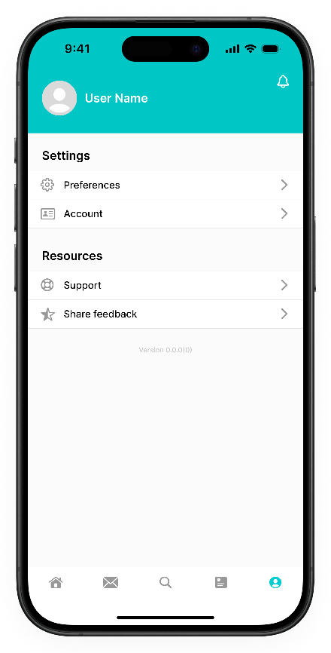
tasktenders
Profile
User’s Screens
Manage Orders

Slide 22
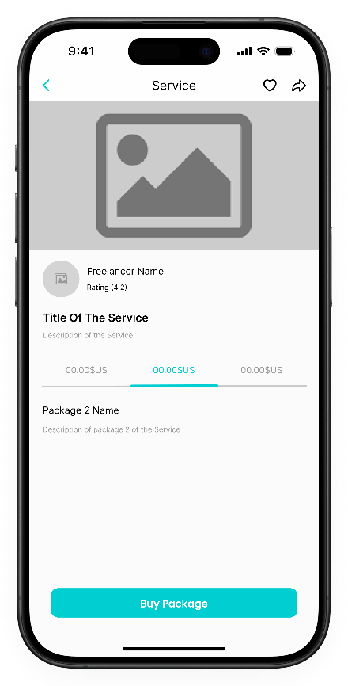
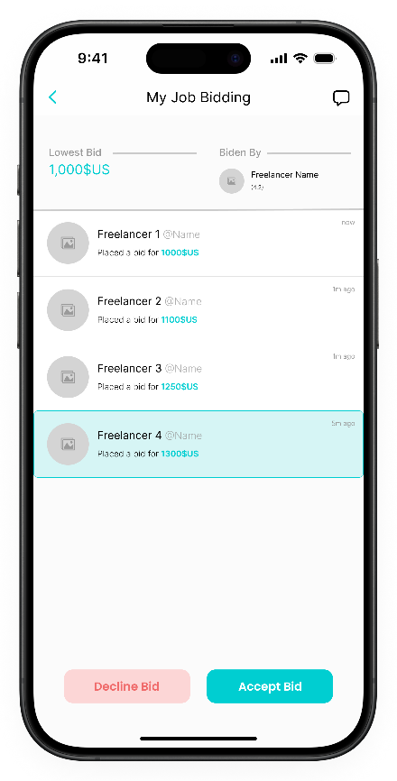
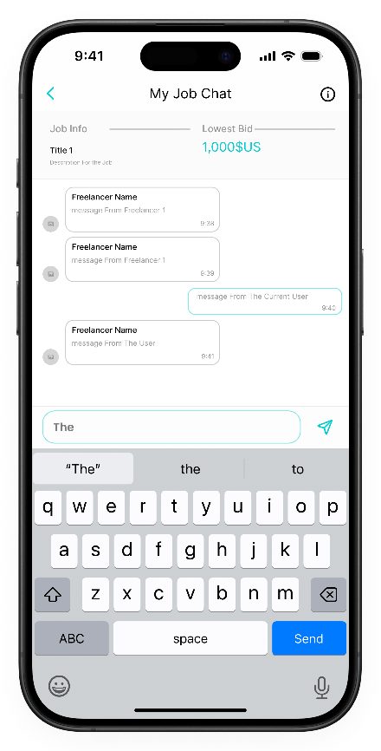
tasktenders
Service View
Per Job Chat
User’s Screens
View Job Bidding

Slide 23
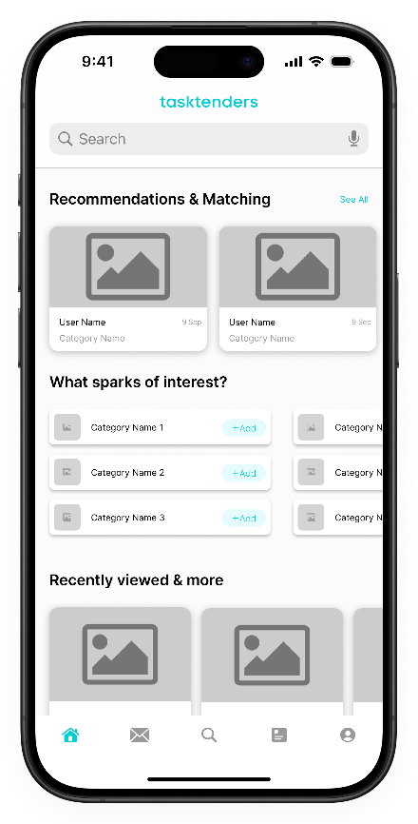
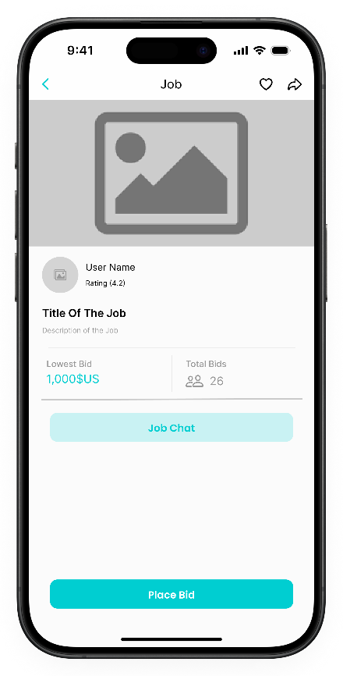
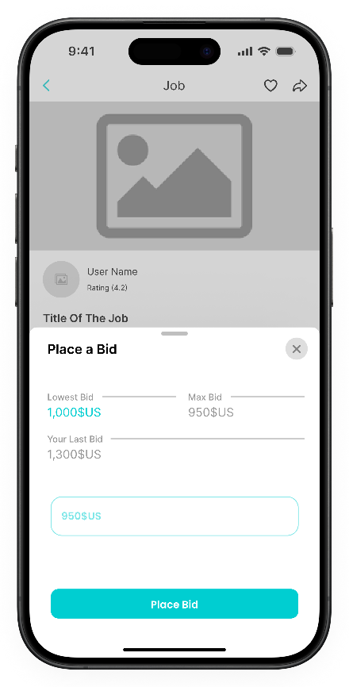
tasktenders
Home Screen
Place a bid
Freelancer’s Screens
View Job

Slide 24
tasktenders
THANK YOU
THANKS FOR LISTENING

